Slide 1
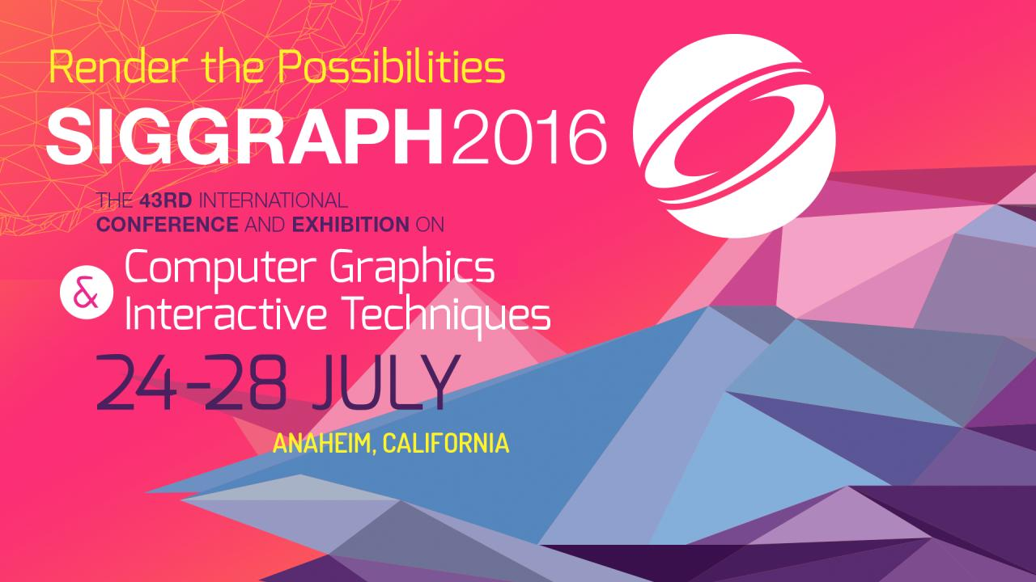

Slide 2


Temporal Antialiasing In Uncharted 4
Ke XU
Naughty Dog
Notes:
Welcome to my talk

Slide 3
Graphics Changes For U4
Fully deferred rendering [Ramy talk]
Physically based rendering
Temporal anti-aliasing
Notes:
Let’s start by looking at the major changes we made to our graphics engine for u4
Deferred rendering – check out Ramy’s talk

Slide 4
PBR Leads To TAA
We used Disney BRDF[1] for PBR
Spec lighting has much worse shader aliasing than last gen
TAA mostly to help shader aliasing, although works well for other aliasing too
Notes:
Actually TAA didn’t come in isolation
It’s because we adopted PBR, and that led to the need for TAA

Slide 5
Shader Aliasing
Like edge aliasing, also caused by under sampling
More noticeable as temporal aliasing
Could be fixed by costly super sampling
Can’t be fixed by regular AA techs[2]

Slide 6
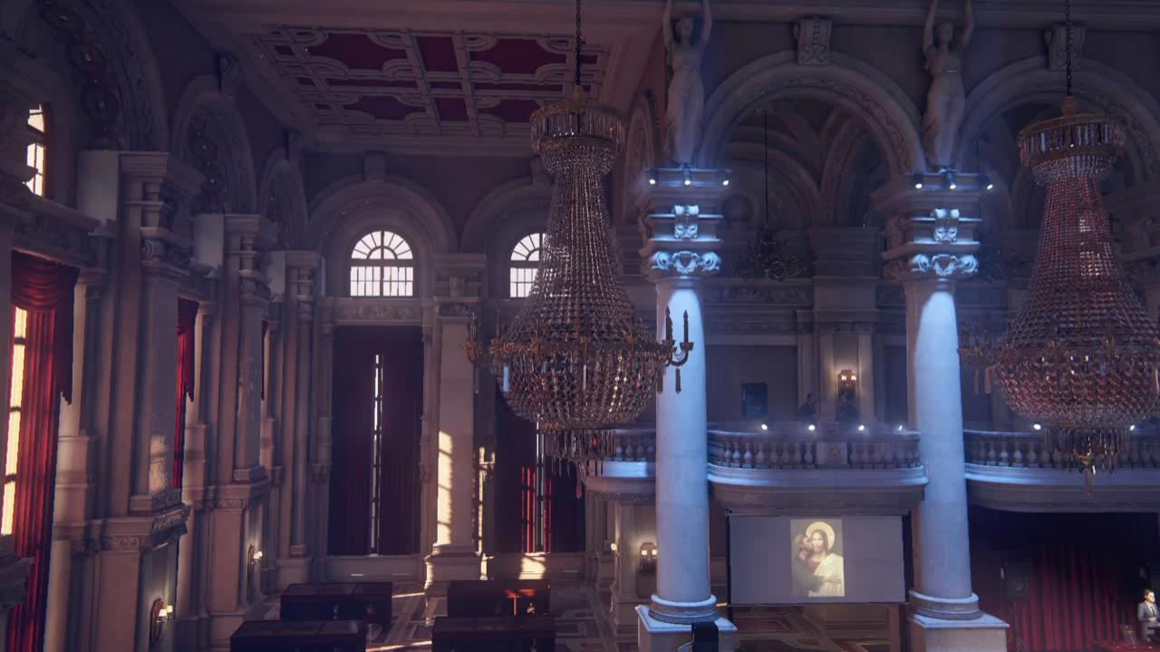
Notes:
Explain how under sampling causes the shader aliasing

Slide 7
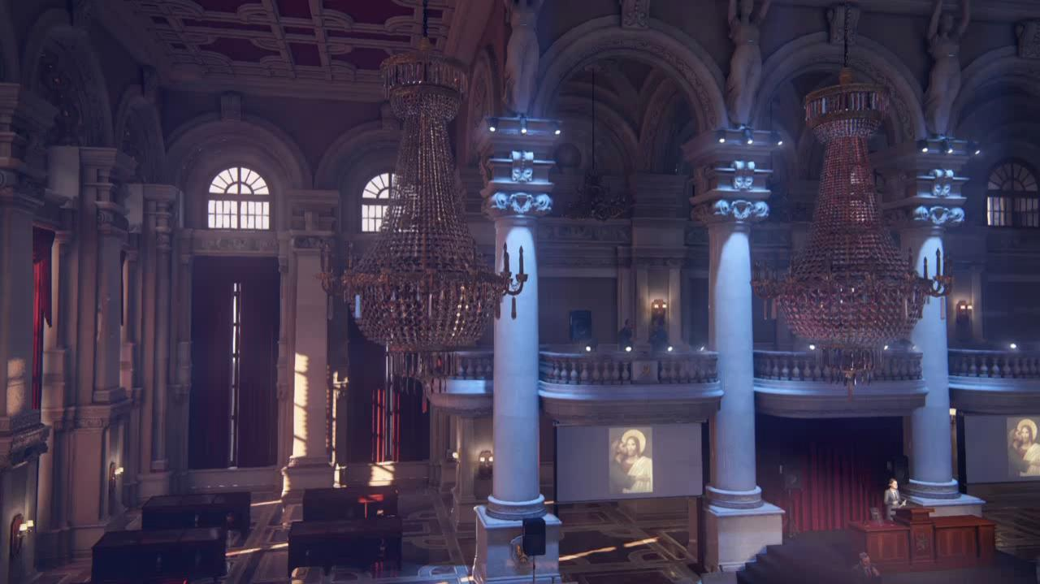
FXAA
Notes:
Let’s try fixing shader aliasing with the popular FXAA
As you can see, no use

Slide 8
Fixing Shader Aliasing
Several methods have been developed
We prefer code change only, no art production pipeline change if possible
Temporal AA seemed a good fit
Notes:
Art production pipeline change would cost way too much resource and time

Slide 9
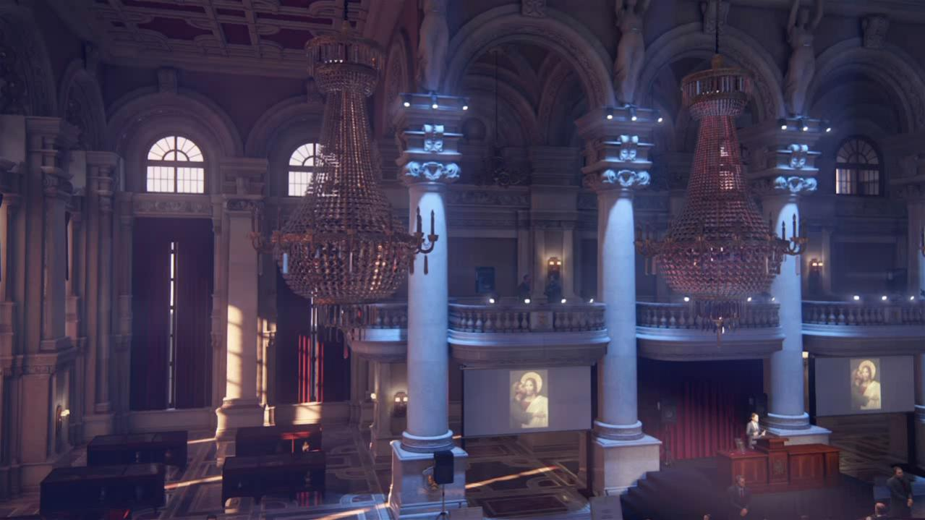
TAA
Notes:
So let’s show the result of temporal AA first

Slide 10
TAA In The Past
Halo: Reach, Assassin’s Creed 4, The Order: 1886, Unreal Engine 4, etc.
Several talks on TAA in the past
This talk focuses more on implementation details

Slide 11
Basic Ideas
Like super sampling, but spread samples across multiple frames
Same as super sampling for static images
Get it working for static image first
Notes:
It’s just like super sampling in that you calculate multiple samples per pixel
But instead of calculating all the samples in the same frame, you spread the calculations across multiple frames
It’s exactly the same as super sampling for static images because multiple frames of a static image is still the same image
Meaning get it working when the game is paused first

Slide 12
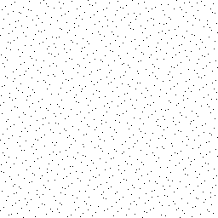
Sample Locations In A Pixel
Halton sequence
Notes:
These are the super sample locations in a single pixel
This is the range of 1 pixel
Black dots are the super sample locations, in Halton sequence, see appendix

Slide 13
Sample Pattern
Convert sample locations to offsets from pixel center, in ndc space unit
Use a different sample to modify projection matrix each frame
Notes:
Generate the super sample locations once during game initialization
Sample locations are in [0, 1] range, convert to offset values from “pixel center”
Technically a pixel is not a little square

Slide 14
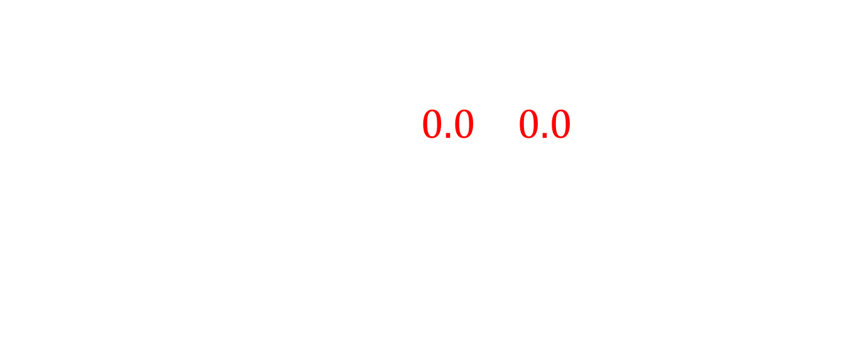
Offset Projection Matrix
Notes:
The elements in red are the offsets to x and y in ndc space
Ndc – normalized device coordinate, a.k.a -1 to 1 space
These elements are usually 0

Slide 15
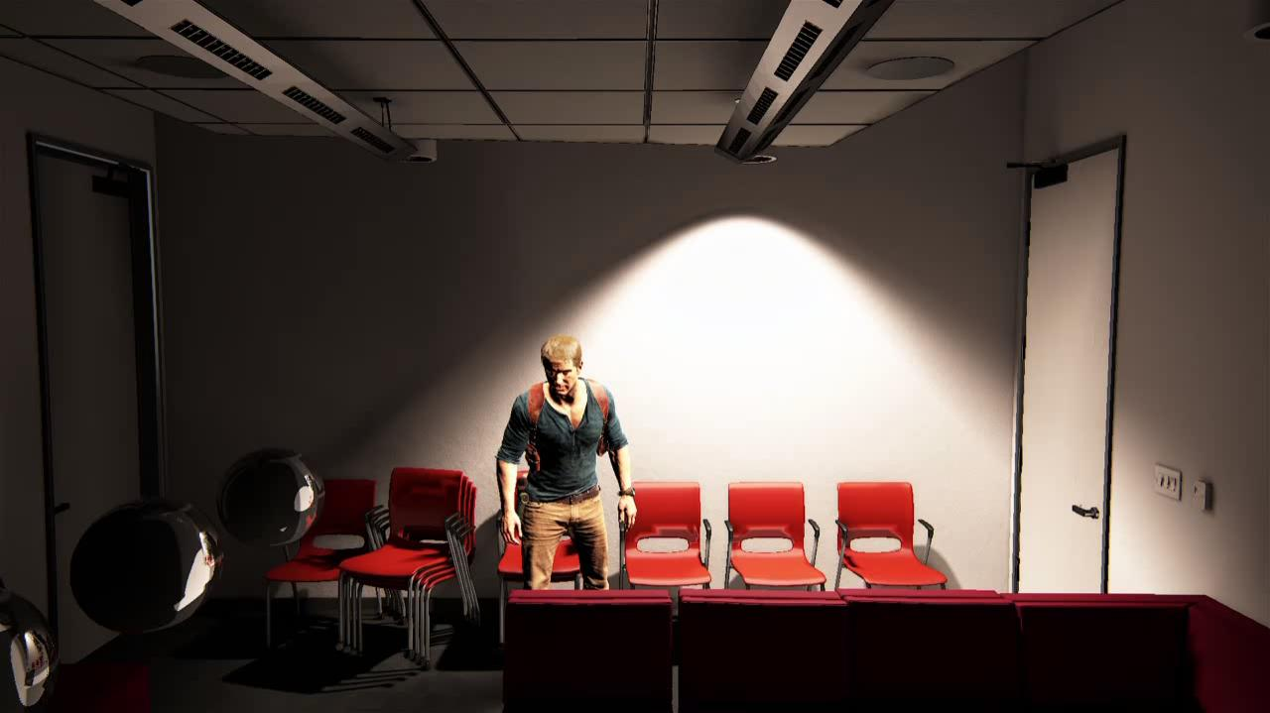
Notes:
Of course just doing this you’ll get jittered images like this video,
because every frame you are slighting moving the image by a different amount
So now we just need to add the TAA shader to make these jittered frames converge

Slide 16
Rendering Pipeline
Depth only pass (main view scene pass)
GBuffer pass (main view scene pass)
Deferred lighting shader ← HDR
Temporal AA
Post processing (tone mapping, motion blur, etc.) ← LDR
Notes:
Let’s take a quick look at the rendering pipeline to see where temporal fits in the big picture.
These are only the relevant part of the pipeline. Omitted shadow passes, etc.
Now the main view passes are all jittered with the projection matrix offsets
Notice we do temporal AA on HDR result, this may be a problem if your dynamic range is very high (converge too slow)
Also note motion blur has to happen after temporal! Otherwise it will screw up the whole image

Slide 17
TAA Shader Structure
Input:
Current frame HDR buffer
Last frame TAA result, a.k.a history buffer
Output:
Current frame TAA result, used as:
Input to current frame post processing pipeline
History buffer input to next frame TAA shader
Needs fp16!
Notes:
The texts in blue refer to the same buffer

Slide 18
Static Image TAA
Set up input & output
Launch full screen shader
Lerp between history and current:
float3 currColor = currBuffer.Load(pos);
float3 historyColor = historyBuffer.Load(pos);
return lerp(historyColor, currColor, 0.05f);
Notes:
Now we are ready to write the shader code for static image TAA
Play with the blend value a little bit:
More weight on current frame color leaves more jitter, but converges faster;
More weight on history color produces more stable, more antialiased image, but converges slower
0.05 is a good value to demonstrate TAA’s quality level using static images
Each new frame only contributes 5% to the final resulting image

Slide 19

Notes:
So let’s look at this shader’s effect on our jittered image
In the beginning it jitters like before
But once the temporal shader kicks in it will stabilize the image and give you an anti-aliased result

Slide 20
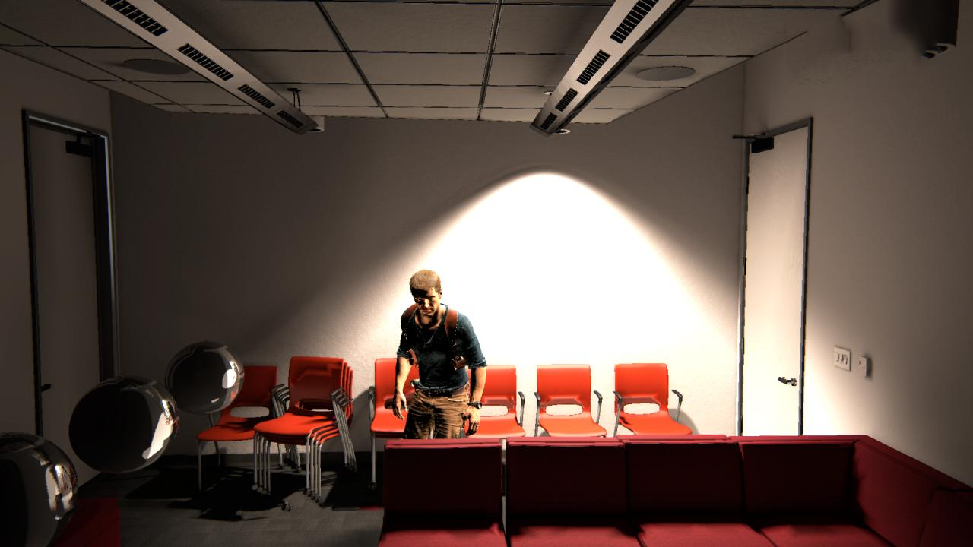
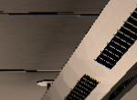
No AA
Notes:
Now let’s do some screenshot comparisons
This is no AA

Slide 21
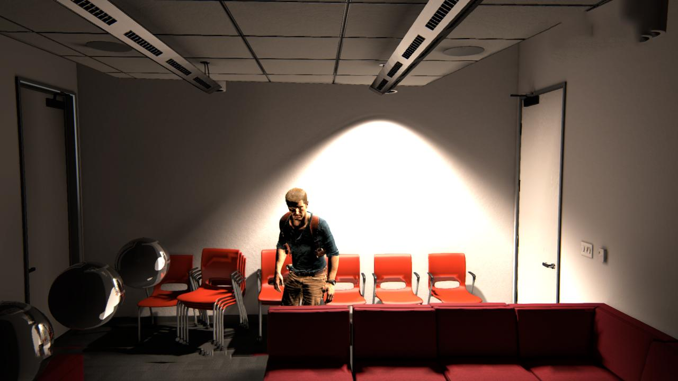
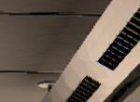
FXAA
Notes:
This is FXAA

Slide 22
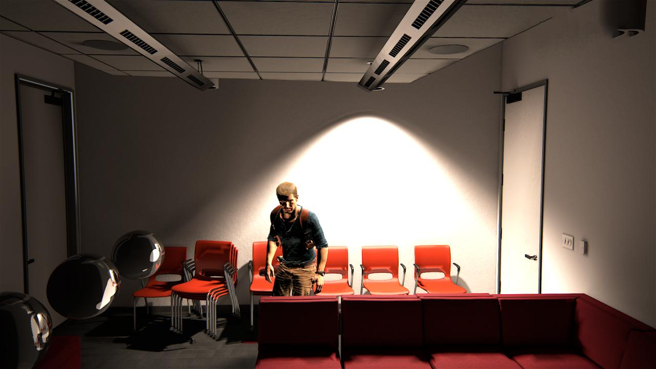

TAA
Notes:
This is temporal AA
It basically fixes all the problems and still remain sharp
As we mentioned before this is the same as brute force super sampling

Slide 23
Moving Images
For moving images, can’t sample history buffer at same position
Find out where current frame pixel was in last frame, if at all:
Outside screen?
Occluded by something else?
Notes:
In the case of moving images, can’t sample the history buffer with the same uv coordinates as when sampling current frame’s color buffer

Slide 24
Motion Vector
Generate full screen motion vector buffer (fp rg16) in GBuffer pass
In GBuffer VS:
posproj = posobj x matwvp
posLastproj = posLastobj x matLastwvp
Notes:
So for this we need motion vector to tell us where the pixel was last frame
In gbuffer pass’s vs, need to output both current and last frame’s projection space positions

Slide 25
Motion Vector
To compute these, need to store:
Last frame camera info
Every object’s last frame mato2w
Every skinned object’s last frame bone positions and:
do skinning twice each frame
output last & current frame’s vertex positions

Slide 26
Motion Vector
In GBuffer PS, output motion vector:
posndc -= g_projOffset;
posLastndc -= g_projOffsetLast;
float2 motionVector =
(posLastndc - posndc) * float2(0.5f, -0.5f);
Notes:
Current frame’s ndc pos is directly available in PS
Last frame’s need to manually divide by w
Important! Need to remove the jitter offset from the ndcs
Don’t want jitter to be counted as motion

Slide 27
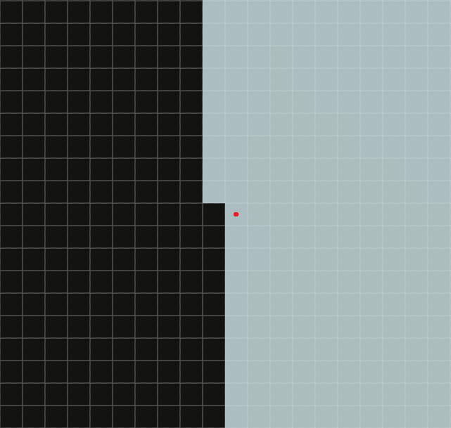
Motion Vector
Notes:
Why not include jitter in motion vector?
Take this pixel on edge for example
This frame it’s white, but due to jitter last frame it could be black
We want to treat both black & white as samples belonging to the same pixel
That’s how you get edge AA
That’s why jitter shouldn’t be counted as motion

Slide 28
Motion Vector
Procedurally animated objects:
Vegetation, hair, etc.
Water vertex movement [Carlos talk]
Do twice for both current & last frames
Needs to be deterministic
Input last frame’s time, produces exact same vertex positions [Andrew & Waylon talk]
Notes:
Just like skinned objects, do twice

Slide 29
Motion Vector
Scrolling uv on textures:
How much change in screen space (deltaX, deltaY) are caused by scrolling in surface uv space (deltaU, deltaV)?
deltaU = ddx(U) * deltaX + ddy(U) * deltaY
deltaV = ddx(V) * deltaX + ddy(V) * deltaY
Solved deltaX & deltaY are in screen pixel unit, convert them to motion vector unit
Notes:
We can relate these 4 variables by using ddx ddy on U and V

Slide 30
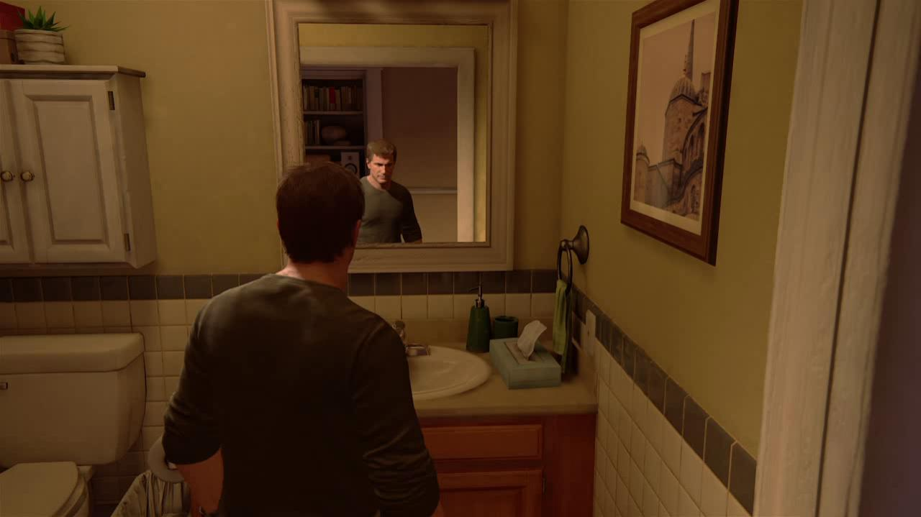
Notes:
Let’s look at a more interesting motion vector case
In our game we have mirror reflections like this one
These are rendered by standard planar reflection method:
Setup a reflection plane where the mirror is
Place a reflection camera symmetrically with the main camera on the other side of reflection plane
Render the scene from the reflection camera into a reflection color buffer
In the mirror’s PS, figure out where in the reflection buffer to sample the reflected color

Slide 31
Motion Vector For Reflection
Can’t use mirror’s motion vector
Which mirror pixel was reflecting the same thing in last frame?
Not hard problem, but involves many steps
See details in appendix
Planar reflection only

Slide 32
Unsupported Motion Vectors
Everything should have motion vector
Still have some unsupported:
Complex texture animations:
Particle smoke, water flow, cloud movement, etc.
Transparent objects:
Artists control motion vectors opacity
Notes:
Transparent is a problem because we only one layer of motion vector buffer

Slide 33
Unsupported Motion Vectors
Why not draw them after TAA?
Drawing order doesn’t always allow
Anything skipping TAA will jitter
Removing jitter not enough:
Tested with jittered depth buffer

Slide 34
Unsupported Motion Vectors
Got away with things after TAA:
Rain drops, bullet tracers, sparks…
Nothing else escaped
Once TAA, have to go all the way
Notes:
These are usually very thin objects, TAA tends to make them disappear completely
They also go by the screen very fast, so the jitter is unoticeable

Slide 35
Motion Vector Precision
Noticed slight jitter in large levels
Camera too far from world origin, causing large numbers in matrices
Solved by “alternative world space” – world space with camera as origin:
posproj = posobj x matobj2alt x matalt2view x matview2proj

Slide 36
Using Motion Vector
Add motion vector buffer as input to TAA
Sample history buffer using motion vector:
float2 uvLast = uv + motionVectorBuffer.Sample(point, uv);
float3 historyColor = historyBuffer.Sample(linear, uvLast);

Slide 37
Using Motion Vector
Important to use linear sampler:
Point sample could land on irrelevant pixel
Linear sample won’t completely miss, but causes blur (addressed later)
Notes:
Because of the way rasterization works
Linear sample makes sure it won’t completely miss the correct history pixel, but it also brings in irrelevant colors

Slide 38
History Mismatch
History & current color may not match:
Non-exist due to occlusion/off screen
Lighting change
On different sides of edge (projection jitter)
Notes:
Lighting changes – shadow, dynamic light…

Slide 39
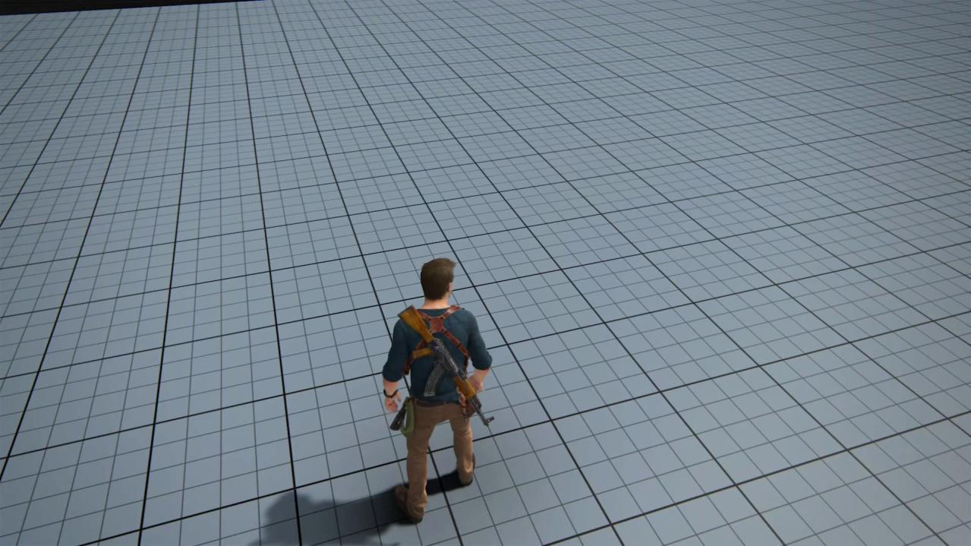

Slide 40
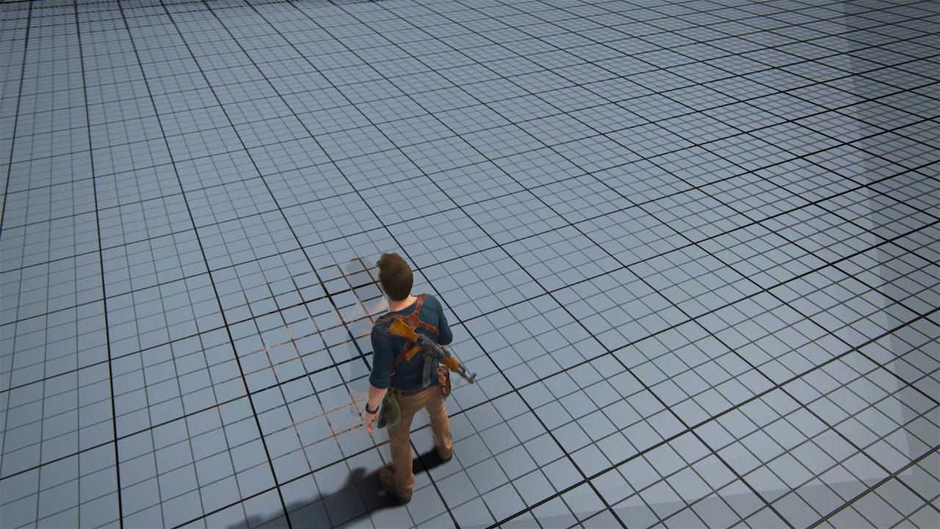

Slide 41
Clamping History Color
Need to clamp history color
Use Dust 514’s[4] clamping method
Sample 3x3 neighborhood centered around current frame pixel
Compute min/max of neighborhood per rgb channel

Slide 42
Clamping History Color
float3 neighborMin, neighborMax;
// calculate neighborMin, neighborMax by
// iterating through 9 pixels in neighborhood
historyColor = clamp(historyColor, neighborMin, neighborMax);

Slide 43
Clamping History Color
For non-exist and lighting change cases, clamp out too different history colors
3x3 neighborhood makes sure clamping doesn’t affect edge AA
For edge pixels, history on the other side of edge won’t be clamped

Slide 44
Blending History Color
Time to blend history and current again, this time supporting moving images:
return lerp(historyColor, currColor,
blendFactor /*0.05f*/);
Need dynamic blendFactor to balance blur and jitter
Notes:
Dynamic means calculated per pixel per frame

Slide 45
Blending History Color
Based on UE4 method[5]:
Increase when local contrast is low; decrease when pixel motion gets subpixel
Decrease when history is near clamp
Result was still a little blurry
Notes:
We calculate the blendFactor based on Unreal method
I’ll give a quick recap here, check out their Siggraph 2014 talk for details

Slide 46

Sharpen Filter

Slide 47
One Remaining Problem
TAA mostly working now
Still had one problem: ghosting
Clamping should have prevented it
Seems not working in some areas
Notes:
The clamping should have prevented it because it clamps out too different colors

Slide 48
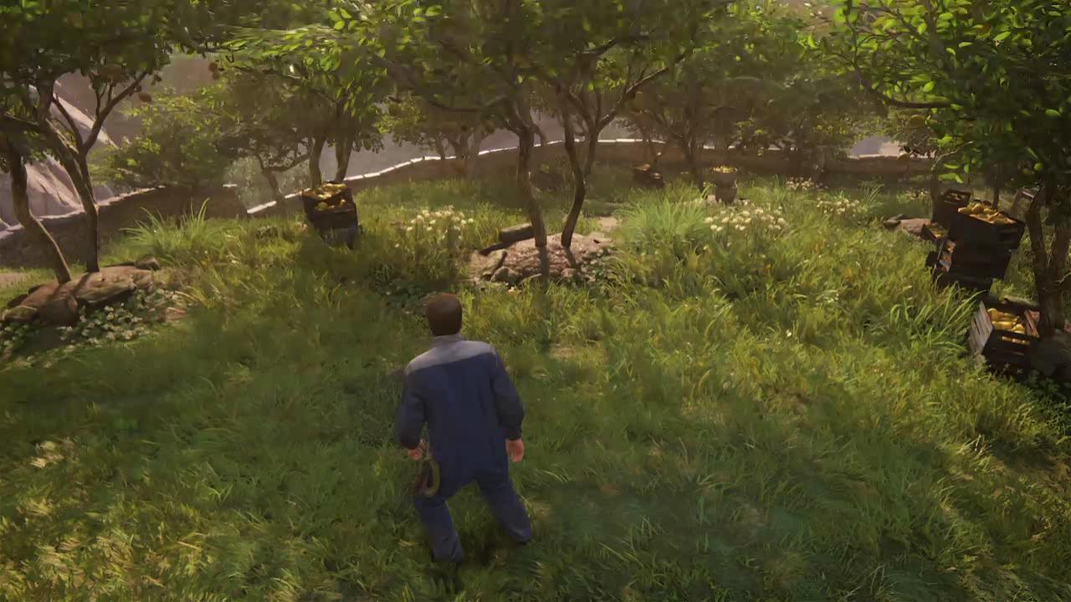
Notes:
Notice how Drake’s head leaves ghosting on the grass

Slide 49
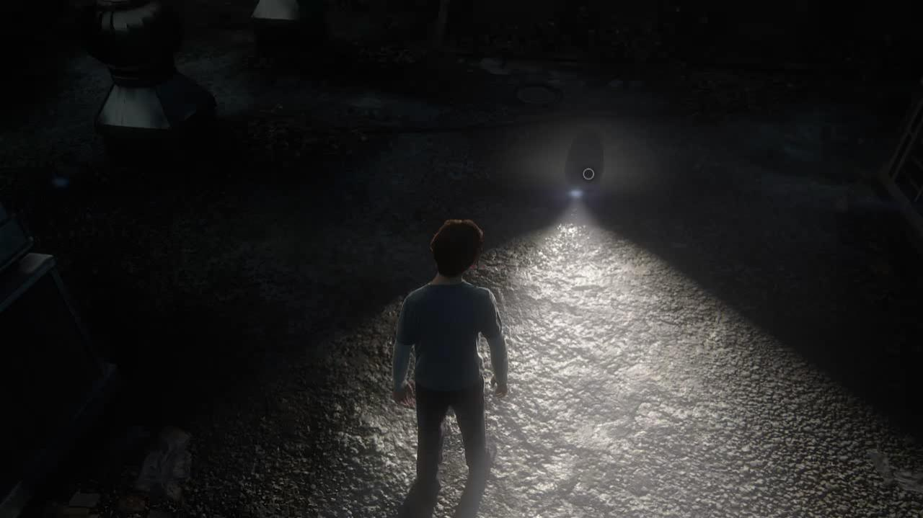
Notes:
Notice how Drake’s head leaves ghosting on the bumpy rooftop

Slide 50
Why Does Ghosting Happen?
Two cases have something in common:
Both contain high frequency & intensity color changes
Dense grass with many edges
Bumpy surface lit by bright light in the dark

Slide 51
Why Does Ghosting Happen?
Remember the clamping?
historyColor = clamp(historyColor, neighborMin, neighborMax);
Neighborhood min/max become huge, making clamp useless
Notes:
You 3x3 neighborhood can contain a big range of colors
historyColor almost always in the range, not getting clampped

Slide 52
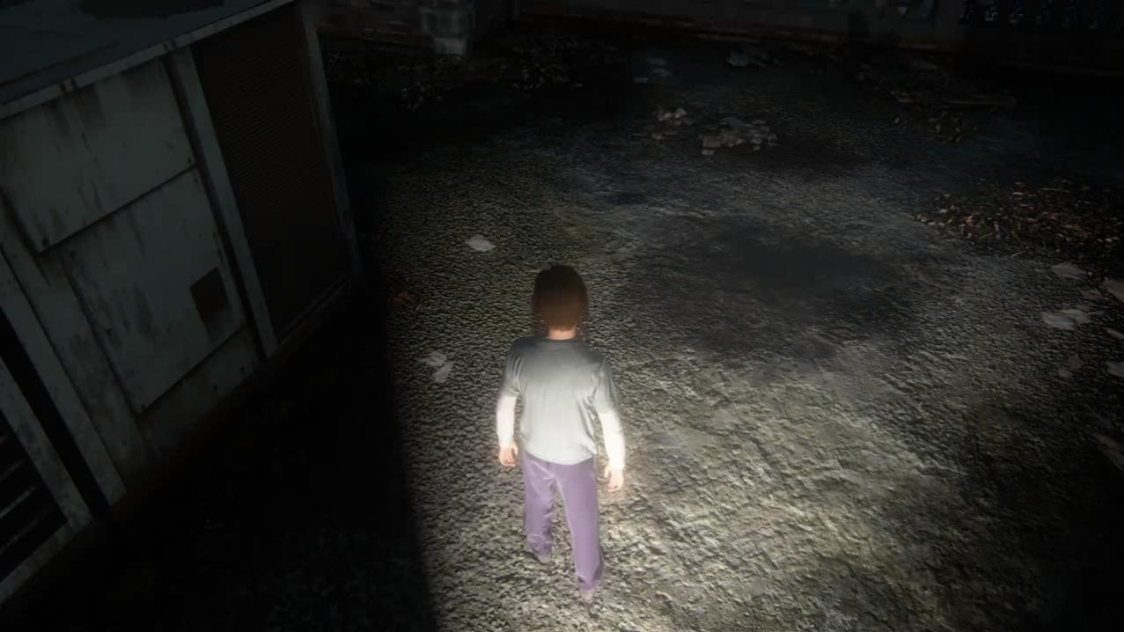
Notes:
To confirm this theory, let’s remove the normal maps from the 2nd case and see if it fixes it

Slide 53
Fix Ghosting Step 1
Use stencil bits to tell objects apart
2 ghosting bits, enough for Uncharted 4
Manually tagged to objects casting ghosting
QA report, artists tag
Add last & current frame stencil as input to TAA shader
Need to save last frame stencil buffer
Notes:
Now that we know the cause of ghosting
We need to help the TAA shader to tell objects apart

Slide 54
Fix Ghosting Step 1
uint currStencil = stencilBuffer.Sample(point, uv);
uint lastStencil = lastStencilBuffer.Sample(point, uvLast);
blendFactor = (lastStencil & 0x18) == (currStencil & 0x18) ? blendFactor : 1.f;
0x18 – the two ghosting bits
Notes:
0x18 because we only use 2 bits of the stencil

Slide 55
Fix Ghosting Step 1
Don’t do this for edges
Edges need to blend across different objects to AA
Edge detection using same 3x3 neighborhood’s ghosting bits
One differs from center means edge

Slide 56
Fix Ghosting Step 2
Ghosting is gone
Newly revealed pixels appear extra sharp and aliased

Slide 57
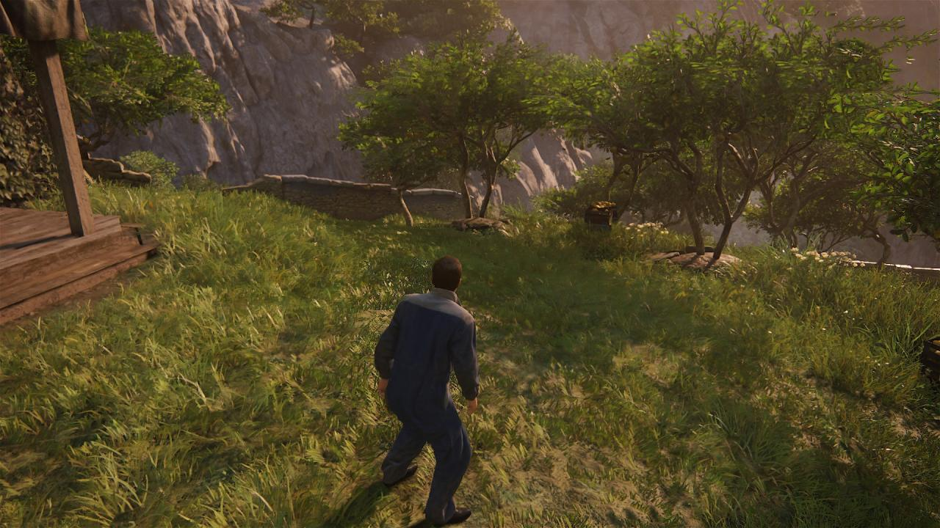
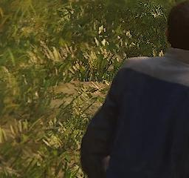
Notes:
But there’s a problem
Instead of ghosting, now we have this
This is when rotating camera to the right, on the left side of Drake the newly revealed pixels appear bad

Slide 58
Fix Ghosting Step 2
Return Gaussian blurred currColor when blendFactor is 1
blendFactor = (lastStencil & 0x18) == (currStencil & 0x18) ? blendFactor : 1.f;
float3 blurredCurrColor;
// Gaussian blur currColor with 3x3 neighborhood
if (blendFactor == 1.f)
return blurredCurrColor;

Slide 59

Fix Ghosting Step 2
Notes:
You can put this in the same loop as the min/max neighborhood and stencil edge detection code, since they are all the same 3x3 neighborhood

Slide 60
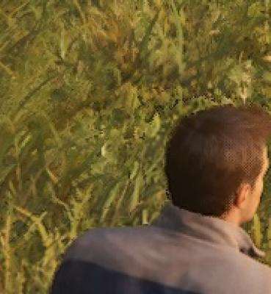
Fix Ghosting Step 3
After stencil fix, still had 1 pixel thick ghosting

Slide 61
Fix Ghosting Step 3
Color history is linearly sampled
Stencil history is point sampled
Mismatch on edge
Solution: make objects outline in stencil buffer expand 1 pixel
Notes:
Even when the stencil test determines equal and should blend, the history color could still contain irrelevant color due to linear filter

Slide 62
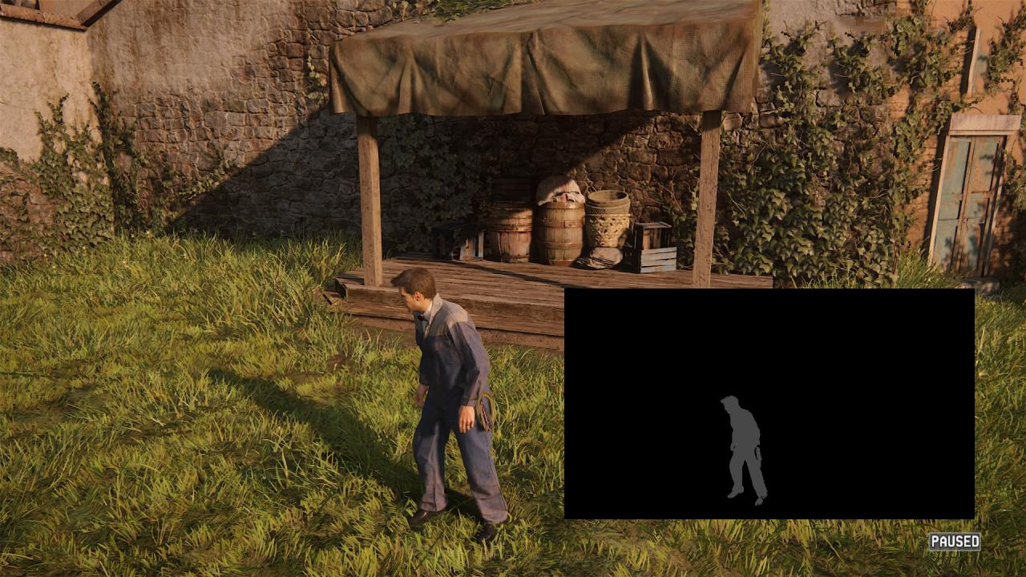
Notes:
Here the stencil buffer is in the lower right corner
The goal is to make Drake’s shape in it one pixel fatter

Slide 63

Fix Ghosting Step 3

Slide 64
Fix Ghosting Step 3
Output stencil of pixel with nearest depth
Add expanded stencil buffer to TAA input
Last frame stencil should come from expanded version
Do stencil test using expanded versions
Edge detection uses unexpanded version

Slide 65
Fix Ghosting Step 3
Fix caused negligible jitter around edge of stencil tagged objects
Avoid tagging things like grass
One reason for manual tagging
Motion blur also hides ghosting
Notes:
Ghosting problem was not bad enough to do systematic fix

Slide 66
History Outside Screen
Pixel history could be off screen last frame
Detect in shader and set blendFactor to 1
Consistent with newly revealed case:
No history → Use Gaussian blurred current color

Slide 67
TAA Performance
Main shader under 0.8ms on PS4 GPU at 1080p
Many other related costs:
Motion vector calculation
Sharpen shader (0.15ms)
Expand stencil shader (0.4ms)

Slide 68
Other TAA Benefits
Graphics features that takes many samples per pixel
Spread computation across multiple frames, use TAA to merge
Will show one example, but used in several more

Slide 69
Reflective Shadow Map
Introduced fully dynamic bounce for flashlight in The Last of Us (PS3) [6]
Reflective shadow map overview:
An instant global illumination algorithm
Generate virtual point lights from lit surfaces
Light the scene with these VPLs

Slide 70
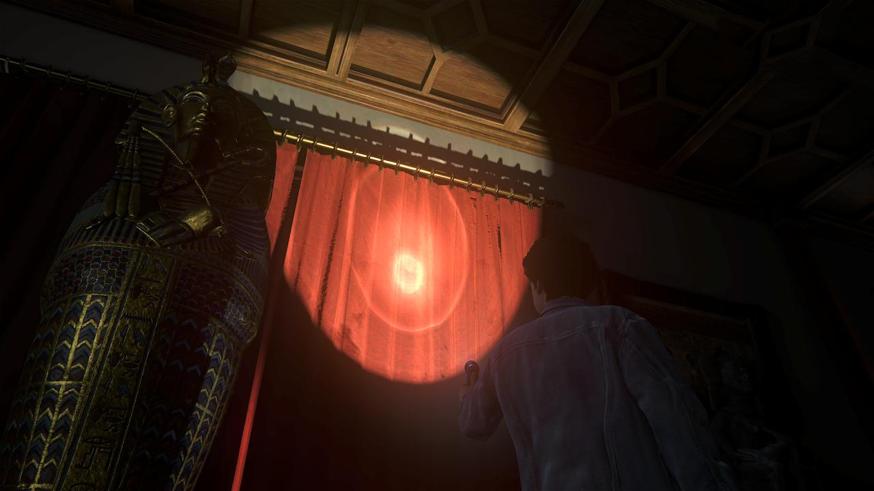

Slide 71
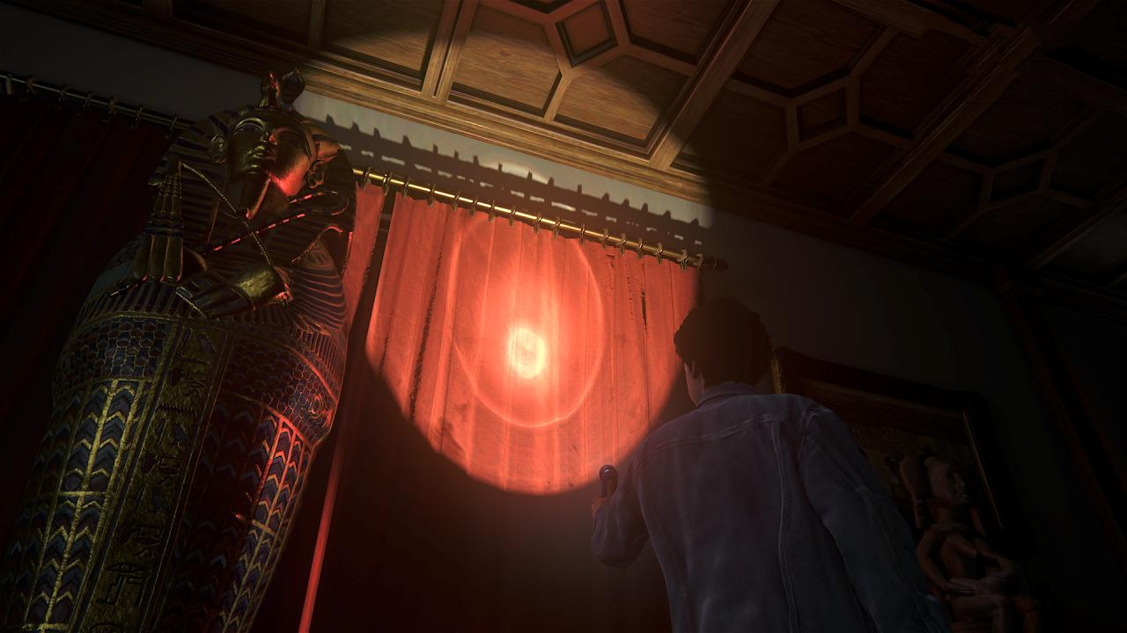

Slide 72
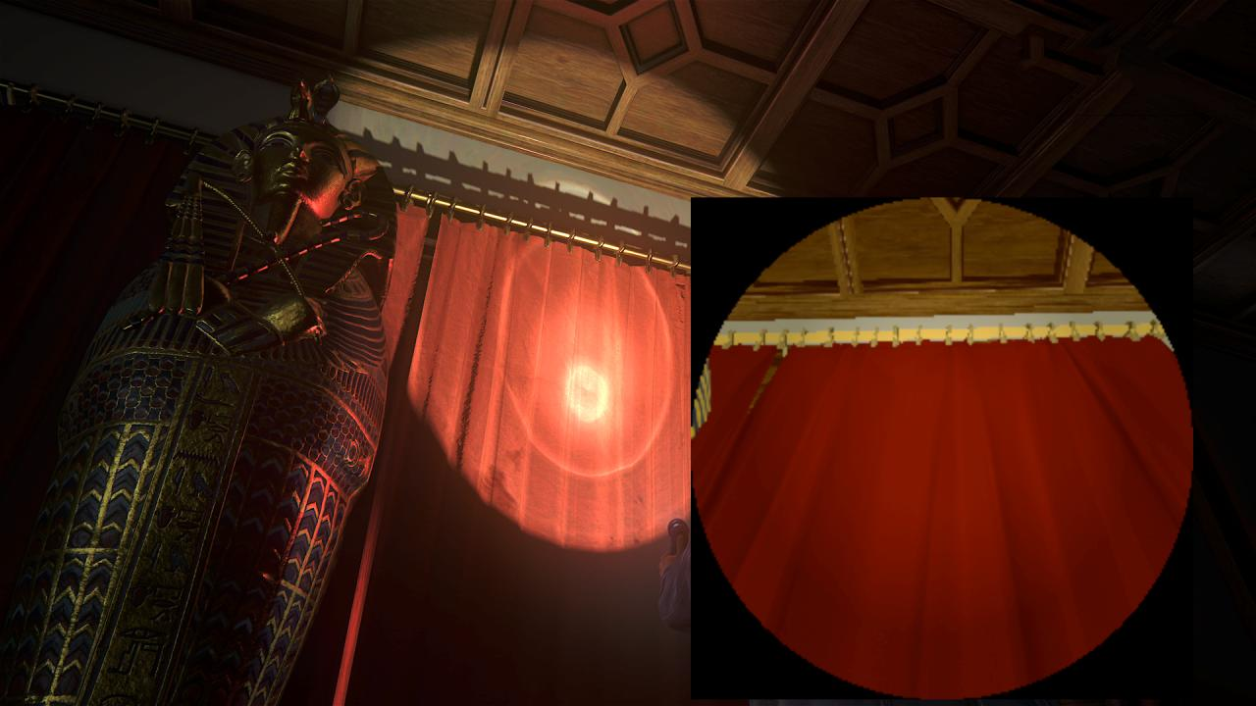
Notes:
The lower right corner is the scene rendered from the flashlight’s perspective
Each pixel in this buffer is a vpl

Slide 73
Reflective Shadow Map
Render scene from flashlight perspective to 256x256 buffer
Each pixel is treated as a VPL
Launch full screen shader where each pixel is lit by ALL (65,536) VPLs
O(n * m) algorithm, too expensive!

Slide 74
RSM In The Last Of Us
How did we run it?
Down sample VPL buffer to 16x16
Full screen shader in 1/4 width x 1/4 height
Not good enough for Uncharted 4:
Result too blurry and aliased
Not enough VPLs (256) causing artifacts
Notes:
So how did we get such expensive algorithm to run in TLOU, especially on ps3?

Slide 75
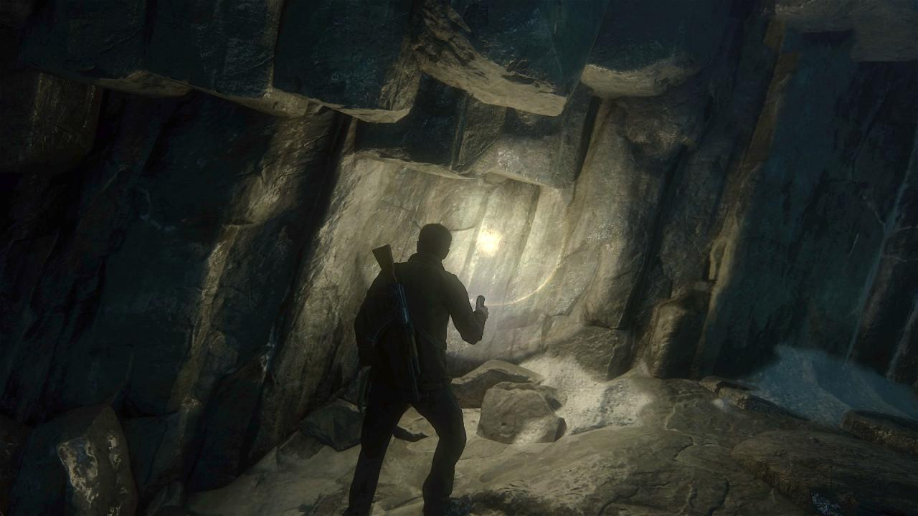
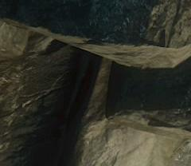
Notes:
Let’s compare the straightly ported over down sampled version with the final shipped version.
Here’s the final shipped version again

Slide 76
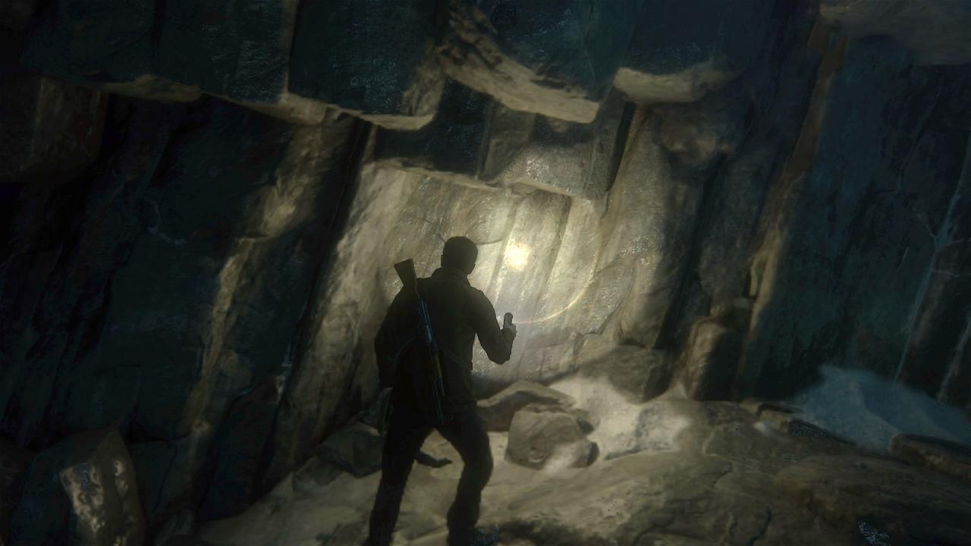
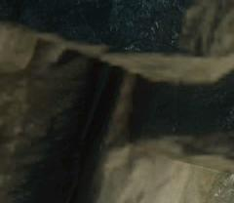
Notes:
This is what the down sampled version looks like
Notice how blurry the bounced lighting is on the mummy

Slide 77
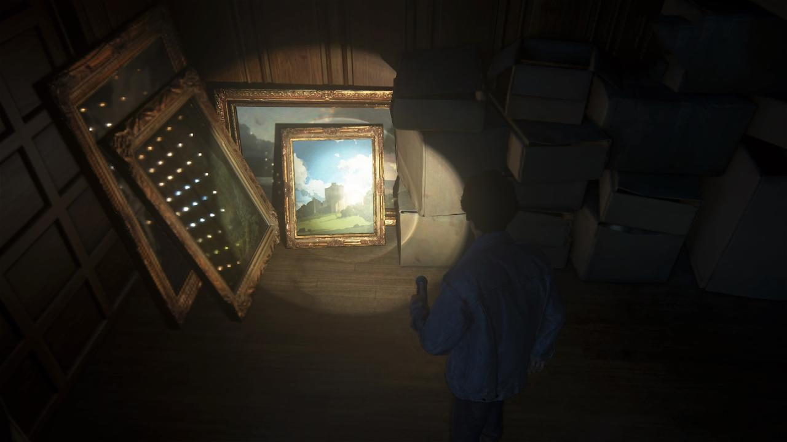
Notes:
You can clearly see the individual vpls in highly specular surfaces
While ideally they should form an area light source

Slide 78
RSM In Uncharted 4
The goals were lofty:
Run lighting shader in 1080p
Use all 64k VPLs per pixel
PS4 is much more powerful than PS3
But not 4x4x256x2.25 = 9216 times more powerful

Slide 79
RSM In Uncharted 4
Needed a less brute force solution
Render resolution can’t budge
Randomly sample 16 VPLs per pixel
Neighbor pixels sample different 16 VPLs
Can cover all 64k VPLs per 64x64 screen space tile
Notes:
To ensure good spatial distribution of the vpls

Slide 80
RSM In Uncharted 4
Use low discrepancy sequence described in PBR book[3]
Ensures no two pixels in 64x64 tile use same VPL
Sampling 16 from 64k has huge variance, resulting severe noise

Slide 81
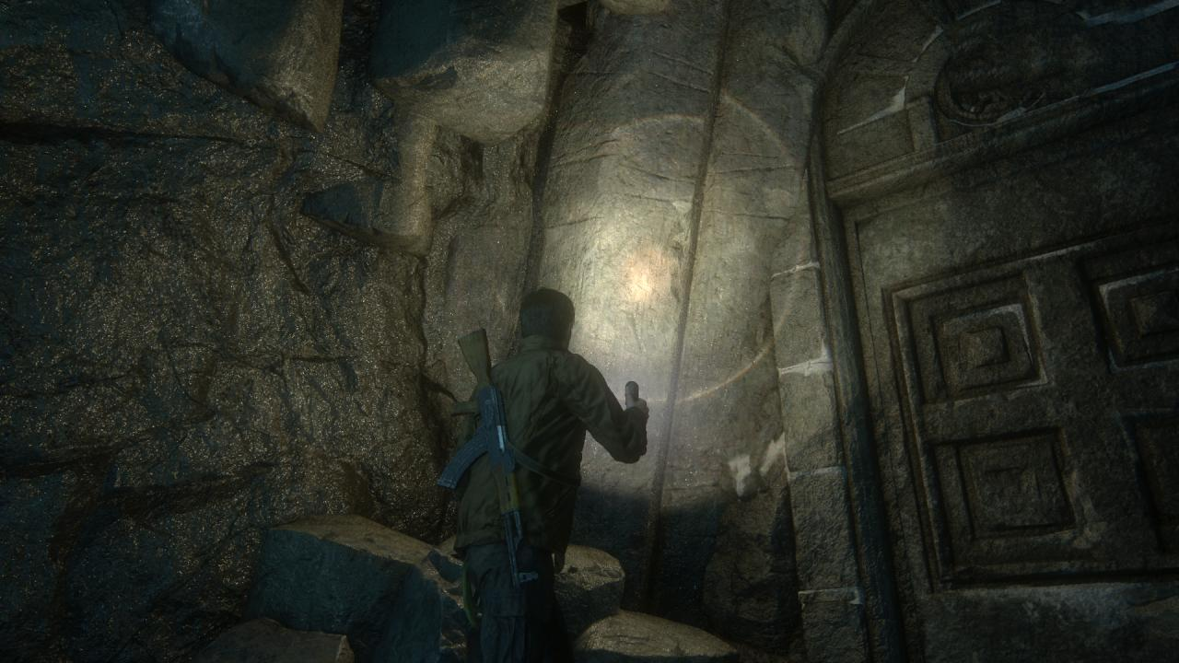
Notes:
As you can see the noisy bounced lighting on the left wall
It’ll look worse when moving

Slide 82
Temporal To Rescue
Each pixel samples different 16 VPLs each frame
Effectively has much more than 16 VPLs
TAA converges the frames to stable image
Best part – no need to change TAA shader

Slide 84
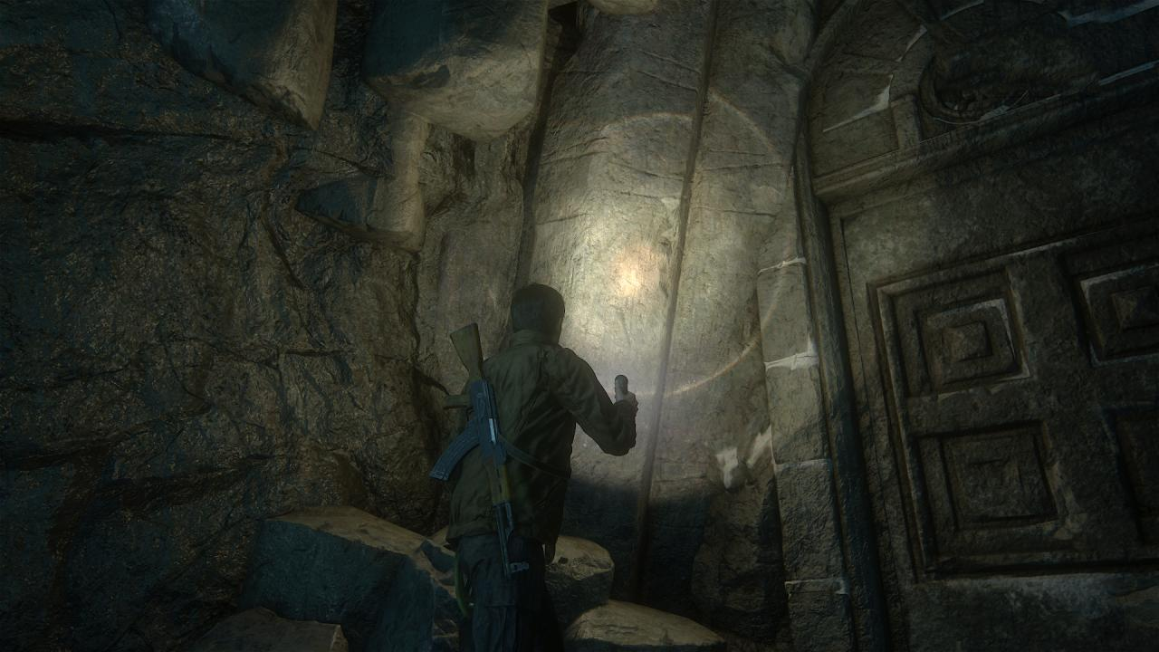

Slide 85
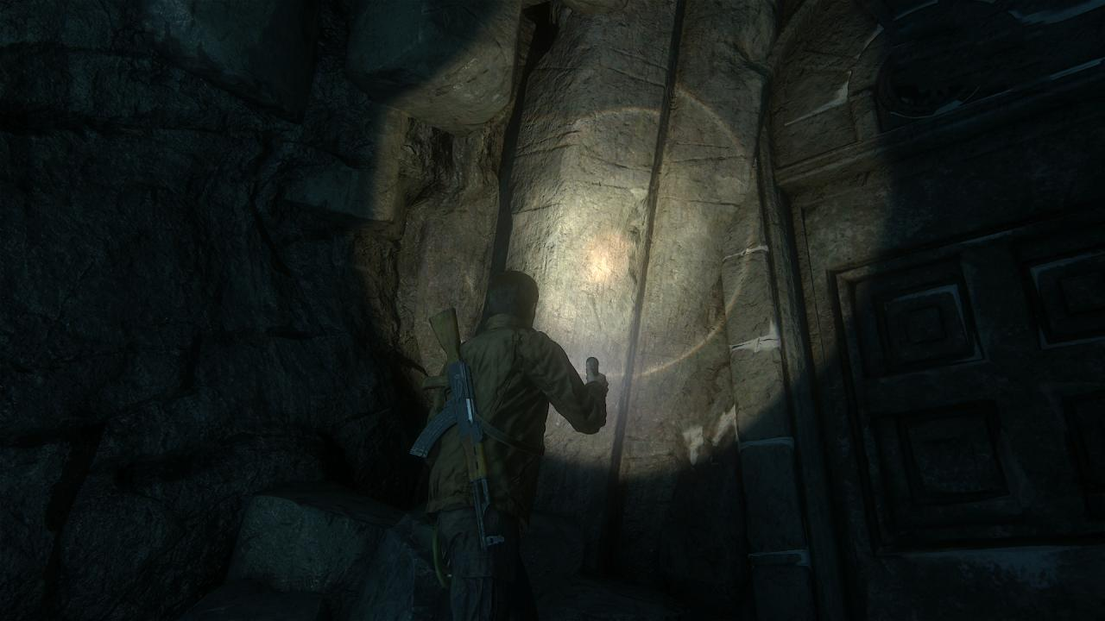
Notes:
This is no bounce light as a reference

Slide 86
Other Features Using TAA
Screen space reflection
Shadow blur
Screen space ambient occlusion
Near camera transparency
LOD transition
Some hair transparency [Yibing talk]
Notes:
All of these benefited from TAA

Slide 87
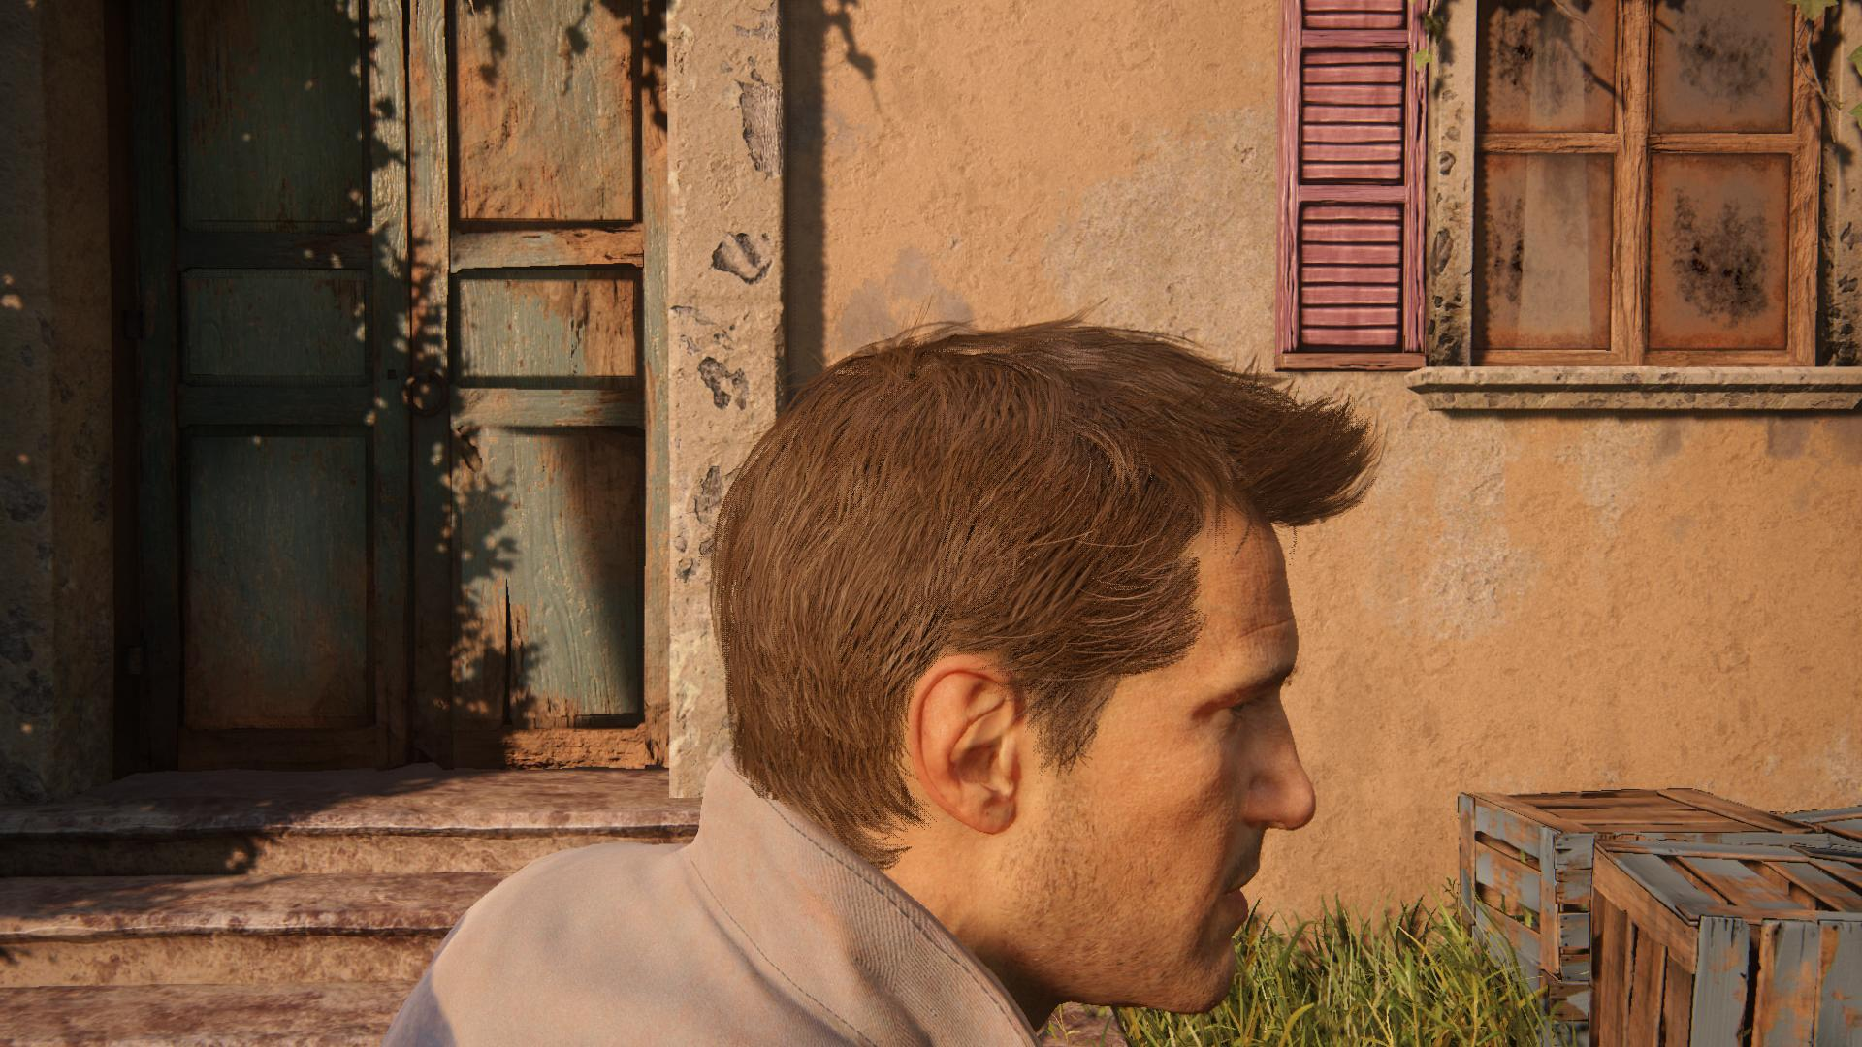
Notes:
Here we will briefly mention hair transparency
Our hair shader is every expensive
Many of them being alpha blend made it worse
We tried to replace some alpha blended hair with screen door transparency based on a dither patter (Bayer patter, see Appendix)
This is what the dithered alpha looks like without temporal
As you can see the dither patter is visible

Slide 88
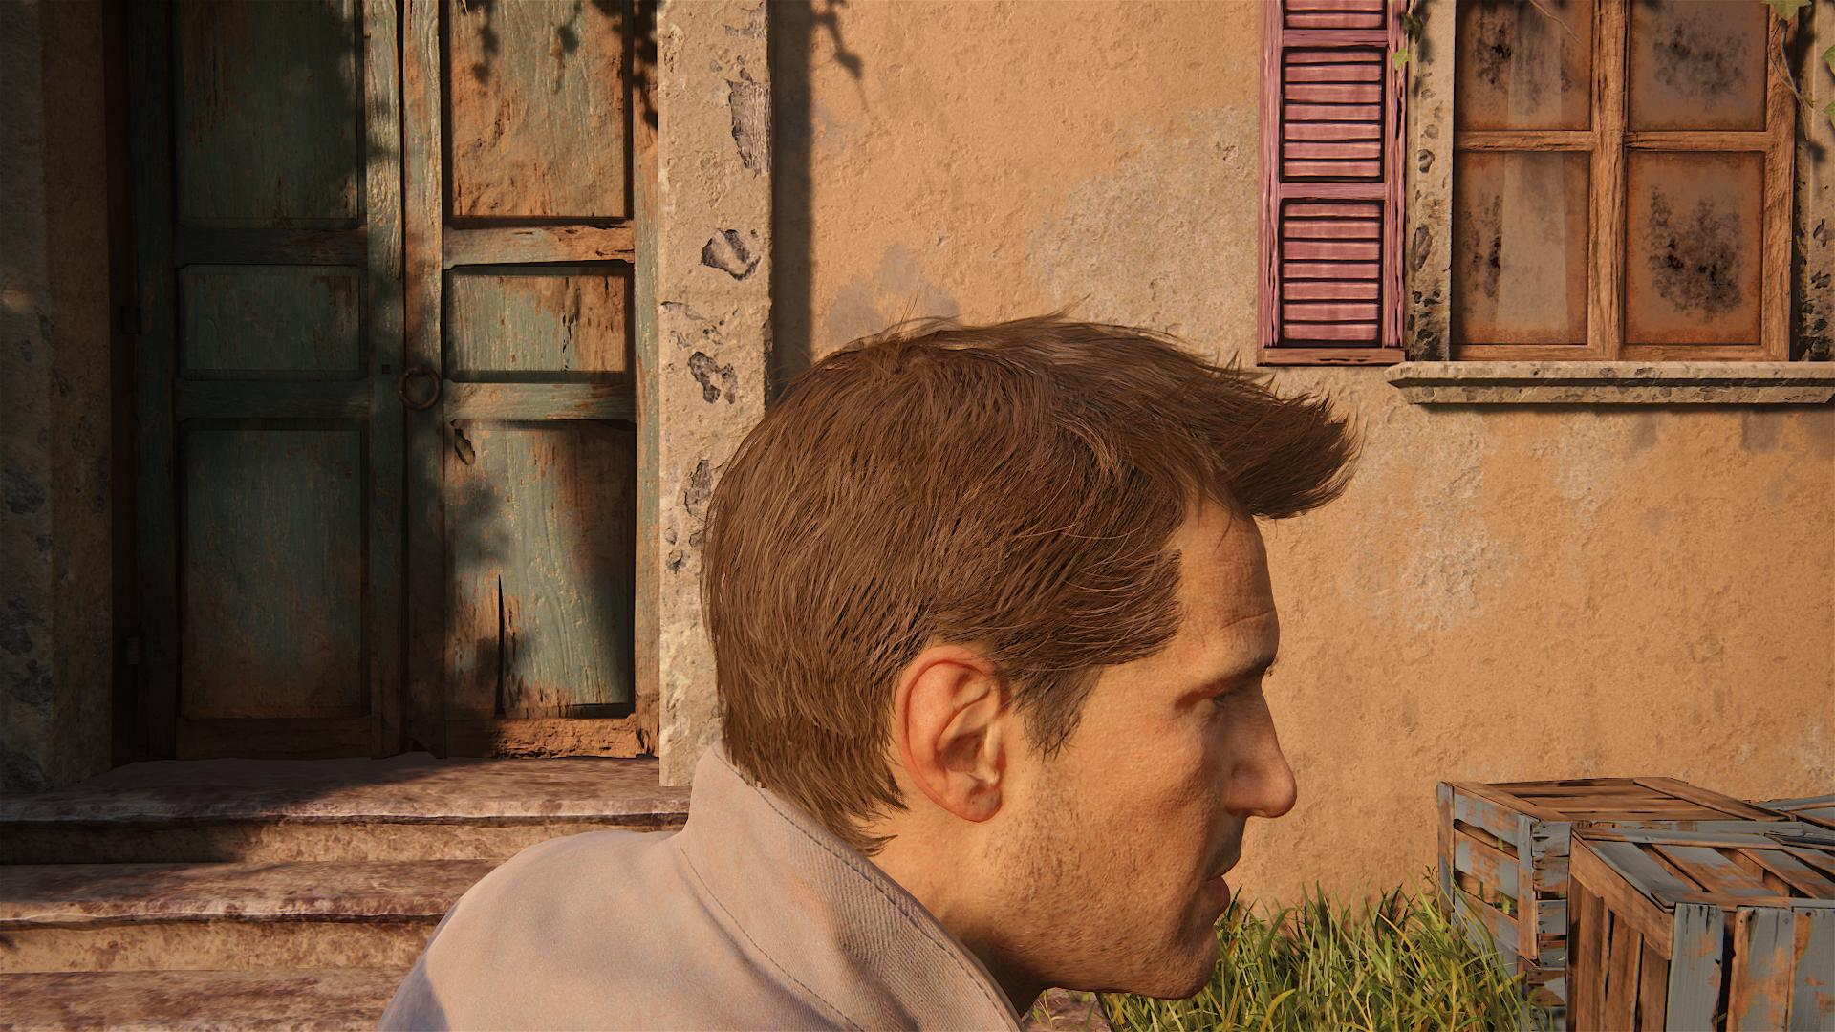
Notes:
Now with the help of temporal
We can change the dither pattern every frame and let temporal to merge them together
Now they look much better, almost like real alpha blend

Slide 89
Unsolved Problems
Unsupported motion vectors
Some particle/water look better without TAA
Down sample & blur not TAA friendly
Couldn’t get SSR to work in half res
TAA works better at higher frame rate
Converge faster, artifacts less noticeable
Notes:
If the current frame input to TAA shader contains down sample or blurred effect, it does a bad job to converge and will leave jitter

Slide 90
Acknowledgement
All developers who contributed ideas to temporal AA
The Naughty Dog team for making the beautiful graphics behind TAA

Slide 91
Join Us!
Check out our opening positions at:
http://www.naughtydog.com/work
Contact:
ke_xu@naughtydog.com

Slide 92
References
[1] https://disney-animation.s3.amazonaws.com/library/s2012_pbs_disney_brdf_notes_v2.pdf
[2] http://openproblems.realtimerendering.com/Salvi_AA_AreWeThereYet.pptx
[3] http://www.pbrt.org/
[4] http://advances.realtimerendering.com/s2012/CCP/Malan-Dust_514_GI_reflections(Siggraph2012).pptx
[5] http://advances.realtimerendering.com/s2014/epic/TemporalAA.pptx
[6] http://www.gdcvault.com/play/1020475/In-Game-and-Cinematic-Lighting

Slide 93
Appendix
Halton sequence
Bayer dither pattern
Motion vector for reflection
Debugging TAA

Slide 94
Halton Sequence
Given n, represent it in base b, flip digits around decimal point
Base 3: ¹⁄₃, ²⁄₃, ¹⁄₉, ⁴⁄₉, ⁷⁄₉, ²⁄₉, ⁵⁄₉, ⁸⁄₉, ¹⁄₂₇,...
To compute the 5th element
5 is 12 in base 3, after flipping is 0.21, which is ⁷⁄₉
Generate X in base 2, Y in base 3, code sample see PBR book[3]
Notes:
So what’s Halton sequence?
It’s pseudo random sample generator that generations low discrepancy samples
What’s low discrepancy?
Basically means the samples are well distributed, no samples clustered together or spaced to far
Different Halton sequences can be generated using different base number.
So to calculate the nth number in a sequence based in b, you need to…
To generate 2D samples which is what we want here, you need to…

Slide 95
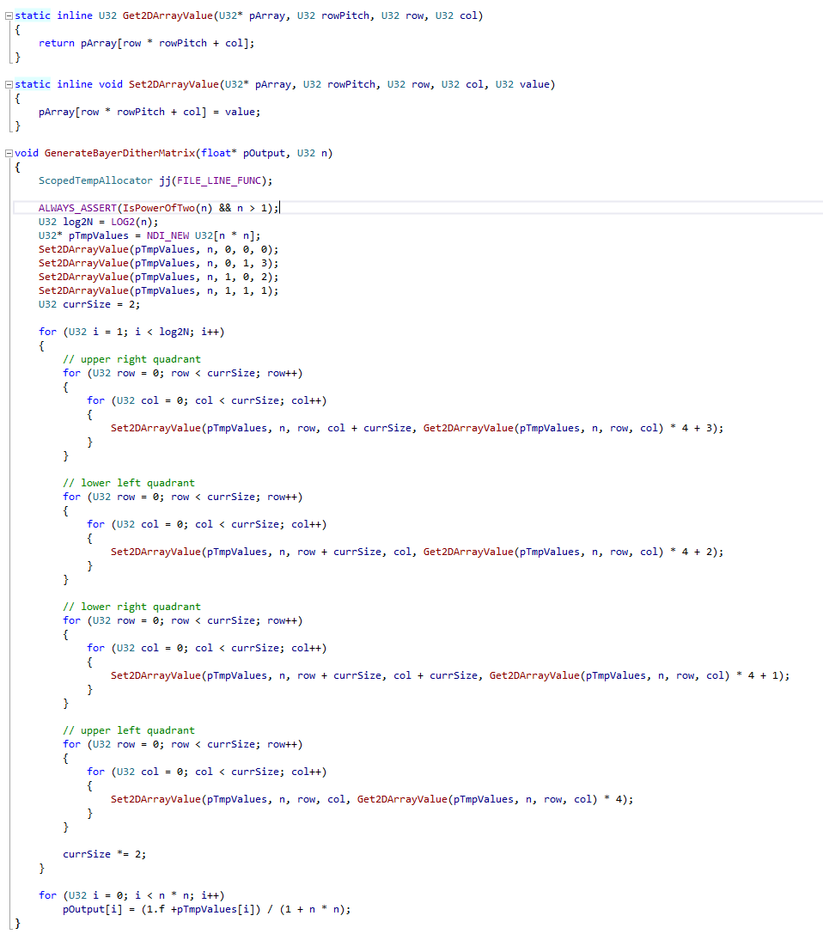
Bayer Dither Pattern
Generates size n (power of 2) square Bayer matrix into an array of floating point numbers between 0.0 and 1.0
Notes:
In shader, overlay this pattern onto n x n size pixel tiles, then kill pixels whose alpha is less than its corresponding value in the Bayer matrix.

Slide 96
Motion Vector For Reflection
Which mirror pixel was reflecting the same thing in last frame?
First, output motion vector buffer for reflection pass
Need to store last frame reflection camera info
Notes:
Normally when you render your reflection pass you only render a color buffer
But now you also need to render a motion vector buffer, the same way as the main camera gbuffer pass

Slide 97
Motion Vector For Reflection
Next, in mirror’s PS:
Compute uv to fetch reflection buffer
Fetch reflection motion vector
Use them to sample last frame reflection depth buffer (need to store it)
Reconstruct reflected point’s last frame world space position
Notes:
Use the same math to compute the uv for sampling reflection color buffer
But use this uv to sample reflection motion vector buffer instead
Follow this motion vector to sample last frame’s reflection depth buffer
Note normally reflection depth buffer is only used for depth testing during reflection render pass, and will be thrown away afterwards. But now need to save it
With this depth and last frame’s reflection camera info, we can reconstruct the reflected point’s world space position in last frame

Slide 98
Motion Vector For Reflection
last frame
world space
reflection cam
intersection point
mirror (reflection plane)
reflected point
main cam
Notes:
The red dot is the reflected point’s world space position in last frame you just reconstructed
Now connect it with last frame’s reflection camera position to form line segment (yellow)
Intersect this line segment with last frame’s reflection plane, to get the mirror pixel that was reflecting the same point last frame
Use last frame’s main camera info to convert this intersection point into ndc space
Output the motion vector by subtracting the current frame mirror pixel’s ndc space position

Slide 99
Debugging TAA
Our engine keeps looping when gameplay logics are paused
TAA keeps converging when paused
Artifacts gone when converged
Add option to stop converging when paused, to see artifacts easily

